Slide 1
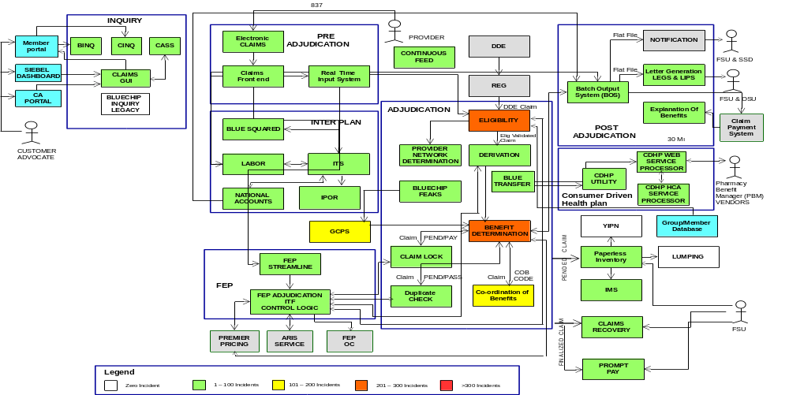
Claims Application Heat Map

Slide 2
Applications
BAM - Blue Access for Members Portal (BAM Portal) is a web-based application that allows members to access coverage and claim information on the internet. Registered member use this tool to view information specific to their claims and membership and perform various functions like status of the claim, coverage plan or requesting for temporary ID card or finding a doctor/hospital. Accessibility and features are available to both, the subscriber and the members.
BINQ - The Benefit & Utilization Inquiry service provides insurance benefits and claims information to their consumers. BINQ is a message resource which provides data across number of access channels that needs contract/benefit information. These access channels are the web portals as well as they are consumers to BINQ.
CINQ - The Claim Inquiry Service is an effort to implement a web-based service to allow applications to inquire upon Claims data, as well to the implement a Claim Inquiry GUI that will be used by Customer Advocates and Claims Processors in the Full Service Units (FSU).
CASS - The Claim Accums Summary Service (CASS) is used to provide Accums total values on plan deductibles and benefit limits. Accumulators are the method of precisely collecting and calculating total claim dollar values against plan deductibles and benefit limits.
Claim GUI - Claims GUI is the replacement of Inquiry process in Legacy system. It's the replacement for IMNU and GMNU screens. IMNU and GMNU are mainframe processes. IMNU has the inquiry process whereas the GMNU has the adjudication process. The inquiry process for the Claims GUI is currently in production, and not the adjudication process. The application is not meant for members or providers information. It's meant to provide Claims information.

Slide 3
Applications
Blue Chip Inquiry - Legacy - The Blue Chip Inquiry system is the tool used by internal and external customers to view claim status and information for claims processed or adjusted in the Blue Chip claims system.
ECLAIMS - ECLAIMS system originated as a separate clearing house application that routed claims from many source. ECLAIMS is not an HCSC BCBS application. The main function of this application is to receive the claims sent in by the providers and make sure it is correctly routed to claim processing system for it to get processed in timely manner.
CFE - Claims Front End (CFE) is the web portal where claims are input, sorted in queues, and fed to the mainframe application for processing. Claim information is verified and checked to make sure RTIS (the mainframe app) can process it and begin the adjudication process.
RTIS - Real Time Input System is a real-time queue based input - feed from Enterprise/Claim Front End (CFE/EFE) which replaces/ retires the BIS batch claim load/monitoring process. The overall business objective for this application is to create a GUI that allows users to view real time statistical totals for processed, carryover, finalized, pended, rejected, recycled, registered, remaining and pend for transmission claims based on line of business, corporate indicator & work item type.
Blue Squared - Blue Squared is application of Blue Cross Blue Shield Association for maintaining the claim processing communication. Blue Squared is a real-time, web-based, service capable application that delivers key business solutions to support the National Account strategy.

Slide 4
Applications
LABOR - Labor Systems were created to accommodate the number of Labor Funds that have independent benefits and membership, yet wanted to take advantage of Health Care Service Corporation's (HCSC) pricing and discounting benefits. Labor Funds are unions that have an administrative agreement with HCSC to process claims.
ITS - ITS (Interplan Teleprocessing System) is a standard set of electronic formats, standard edits and databases, it supports claims, inquiries, membership, Provider data and financial information, and entails performance standards and reporting.
National Accounts - National Accounts is an entity with employee and/or retiree locations in more than one Licensee’s Service Area.
IPOR - IPOR is a datamart that is populated with claim data from ITS Formats database.
GCPS - Generic Contract Processing System (GCPS) represents (in code) all benefits and an exception of a contract as it is used by Blue Chip. This system maintains group contract information, used by Blue-chip to validate and adjudicate claims.
FEP - FEP (Federal Employee Program) program has a national claims system through which all FEP plans process medical claims. It applies benefits and accumulators, edits for validity and compatibility, etc., and performs the final adjudication of the claim.
Eligibility - Eligibility checks edits and validates at the beginning of the Claim processing system to ensure that the member is eligible for services being received.

Slide 5
Applications
Provider Network Determination - Provider Network Determination (PND) offers more customizable networks with multiple tiers, while leveraging relevant existing CCSP C&BD Provider Networks. It provides a positive customer experience for employers and members that seek to improve quality and lower costs of health care.
Derivation - The derivation component takes input as procedure codes and diagnosis code from service and claim line and obtains benefit codes, category codes, types of service and Provision IDs as an output.
BlueChip FEAKs - FEAK (Functional Equivalent Adjudication Key) is a system and these Keys are fields created from GCPS. FEAKs are basically Keys to the Accum Benefits that the Group wants linked together. FEAKS are used during Bluechip adjudication to help determine the utilization of benefits based on the Group’s decision.
Blue Transfer - Blue Transfer is a set of functionalities around the Pharmacy (RX) claims processing. In the Blue Transfer application the Pharmacy vendor and the HCSC are the transaction partner, they share the Accumulator Bucket and the amount is called shared accumes. Accumes are the amount collected during the Pharmacy, Behavioral, Pediatric Dental related visit some of the accumes examples are deductible, co-pay, out-of-pocket etc. Shared accumes means the accume amount will be shared by the member and by the Health Insurance Company which is clearly agreed and coded in the plan agreement and will be provided to the vendor and the amount will be collected by the vendor and will be added in the accumulator bucket.
Benefit Determination - Benefit Determination is a part of Claims Adjudication process which happens at service level. Benefit Determination will address benefit coding limitations and create a member centric focus to allow for benefit customization and increased flexibility.

Slide 6
Applications
Claim Lock - The Claim Lock system is a mechanism to aid in the investigation of fraud and abuse of claims and to ensure that claims are being paid correctly. The system allows values to be assigned up to ten predefined data fields. Once a value or values have been assigned the lock is created.
Dup Check - This component be used by operators to investigate claims pended as potential duplicates by the DuplicateCheck (DuCk) Validate Duplicate Service. Operators will be able to deny duplicate claims, allow non-duplicates to continue processing, or pend the claim again for further investigation.
COB - Co-ordination Of Benefits: Determining the order in other words methods of determining which benefits needs to be paid if the member has two or more policies in different companies.
BOS - The Batch Output System (BOS) / Super Handler component is a set of Post-Adjudication functions that serve as an edit and interface to other Blue Chip and “backend” (non-Blue Chip) functions. Claims are released into the BOS function after they are successfully processed through the Blue Chip Adjudication system.
Notification - Set of reports to provide an audit trail related to the various types of claims and the processing of those claims.
LEGS - Letter Extract Generation System, LIPS - Letter Inquiry Processing System - LEGS & LIPS are automated letter writing systems which assist the customer service representatives produce quality written correspondence. The letters generated from LEGS are related to specific claim situations and are sent to the operational service center (OSC) for distribution. The letters generated from LIPS cover other situations that are not covered by LEGS and are sent to the FSU or the OSC for distribution.

Slide 7
Applications
EOB - EOB describes the receipt of the claim benefits which creates the notifications (either in printable format or VDR-View direct reports) for the subscriber/Member only for the finalized claims (Paid/Rejected status & not for Pended claims).
CDHP Web Service Processor - CDHP (Consumer Driven Health Plan) Web Service Processor is the system that processes web services meant for sending claims information to and receiving pharmaceutical information from external PBM (Pharmacy Benefit Manager) vendors.
CDHP HCA Processor - HCA(Health Care Account) processor process all transactions to update HCA balance. It handles all the inbound and outbound updates with the external PBMs (pharmacy benefits manager).
YIPN - YIPN allows application supervisors to assign claims pages to users so that users can login and select the pages they would like to work on. User can also see the results of the worked pages on screen. YIPN is called from Paperless Inventory application (PI).
Paperless Inventory - Paperless Inventory (PI) is a claims inventory distribution application that automatically allows for the assignment of various inventory types by business days. Distributes work based on predefined criteria set up by supervisors and administrators and Retrieves claims for processing.
Lumping - Lumping is the application which was used to overcome the limitation in viewing more lines of claim details in Blue Chip screen.

Slide 8
Applications
IMS - Inventory Management Systems is a reporting tool used by users to generate reports for processed claims. The Claims Inventory system generates daily, weekly, monthly, and quarterly reports for all claims in the Blue Chip Adjudication system. These reports are utilized in the claims processing areas by operators and management personnel.
Claims Recovery - The application allows users to analyze paid claims and identify claims that were overpaid. It provides various reports to CRU (Claims Recovery Unit) for monitoring inventory status of the recoverable claims. Various reports in this application allow users to see the detail of the potential recoverable claims to help them determine if the claim has been truly overpaid. Every night data for overpaid claims are sent to a database inventory for further processing the data.
Prompt Pay - Prompt Pay calculates and stored interest payment penalties for claims that have been paid late. An automated process for this calculation exists for Illinois, New Mexico, Oklahoma, and Montana regions. Manual calculation process involves for all the states except MT for Adjustments, since all the claims are pushed regardless of cycle time. The Prompt Pay project is currently a child application of Paperless Inventory, contained entirely within the parent project.

